Slide 1


Intro to Philippians…
Acts 16 –
The Birth of the Church in Philippi
Preached by Dan Bridges
Amman International Church, Jordan (AmmanChurch.org)
Uploaded by Dr. Rick Griffith • Jordan Evangelical Theological Seminary
Files in many languages for free download at BibleStudyDownloads.org

Slide 2
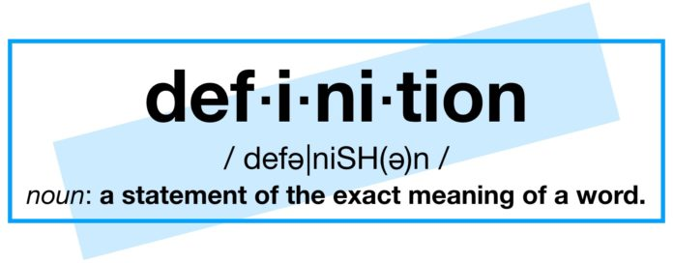
Attend…
Participate…

Slide 3
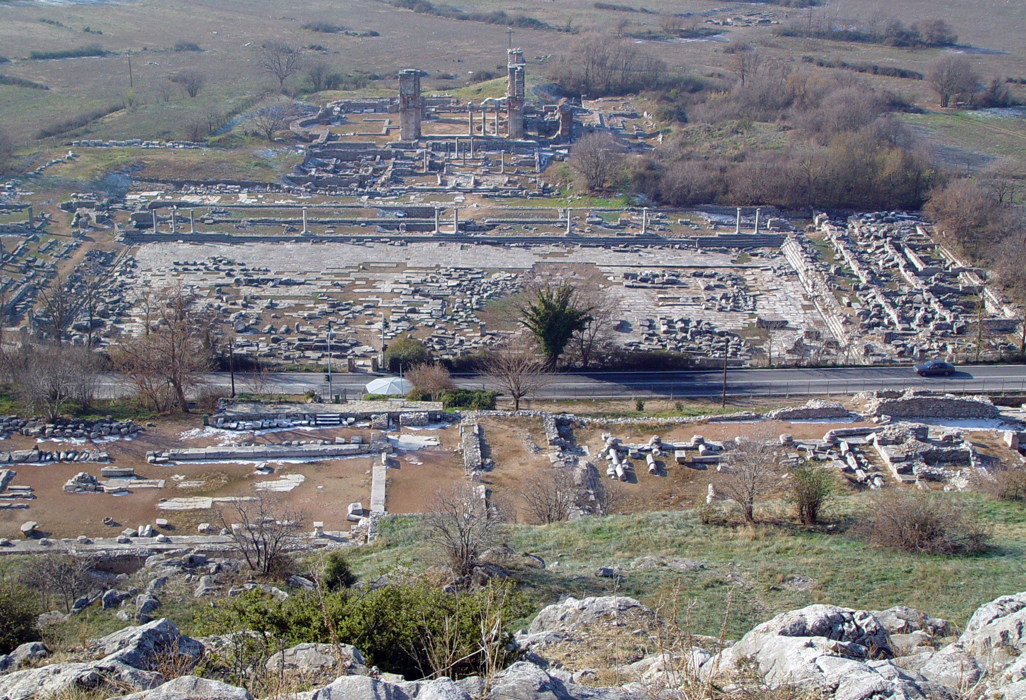
Acts 16
The birth of the church in Philippi

Slide 4
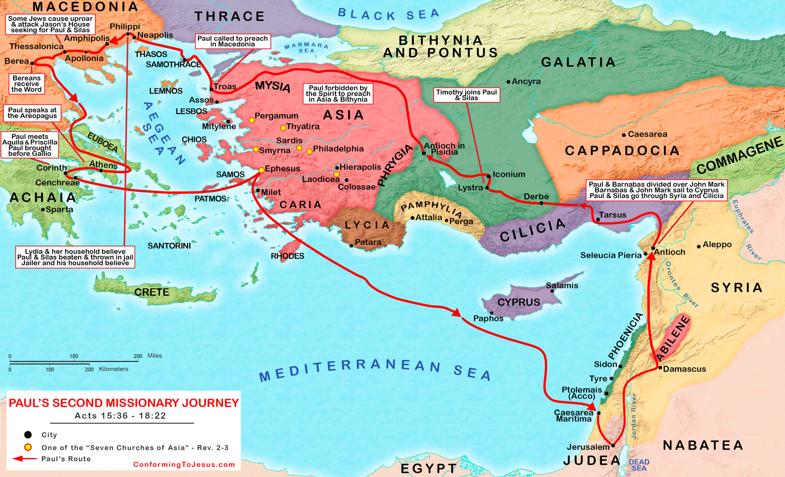
Acts 16:1-10
Travel to Galatia – Jerusalem council report
Timothy joins in Lystra
Visits to Asia & Bithynia prohibited
At Troas – Vision of Macedonian man

Slide 5
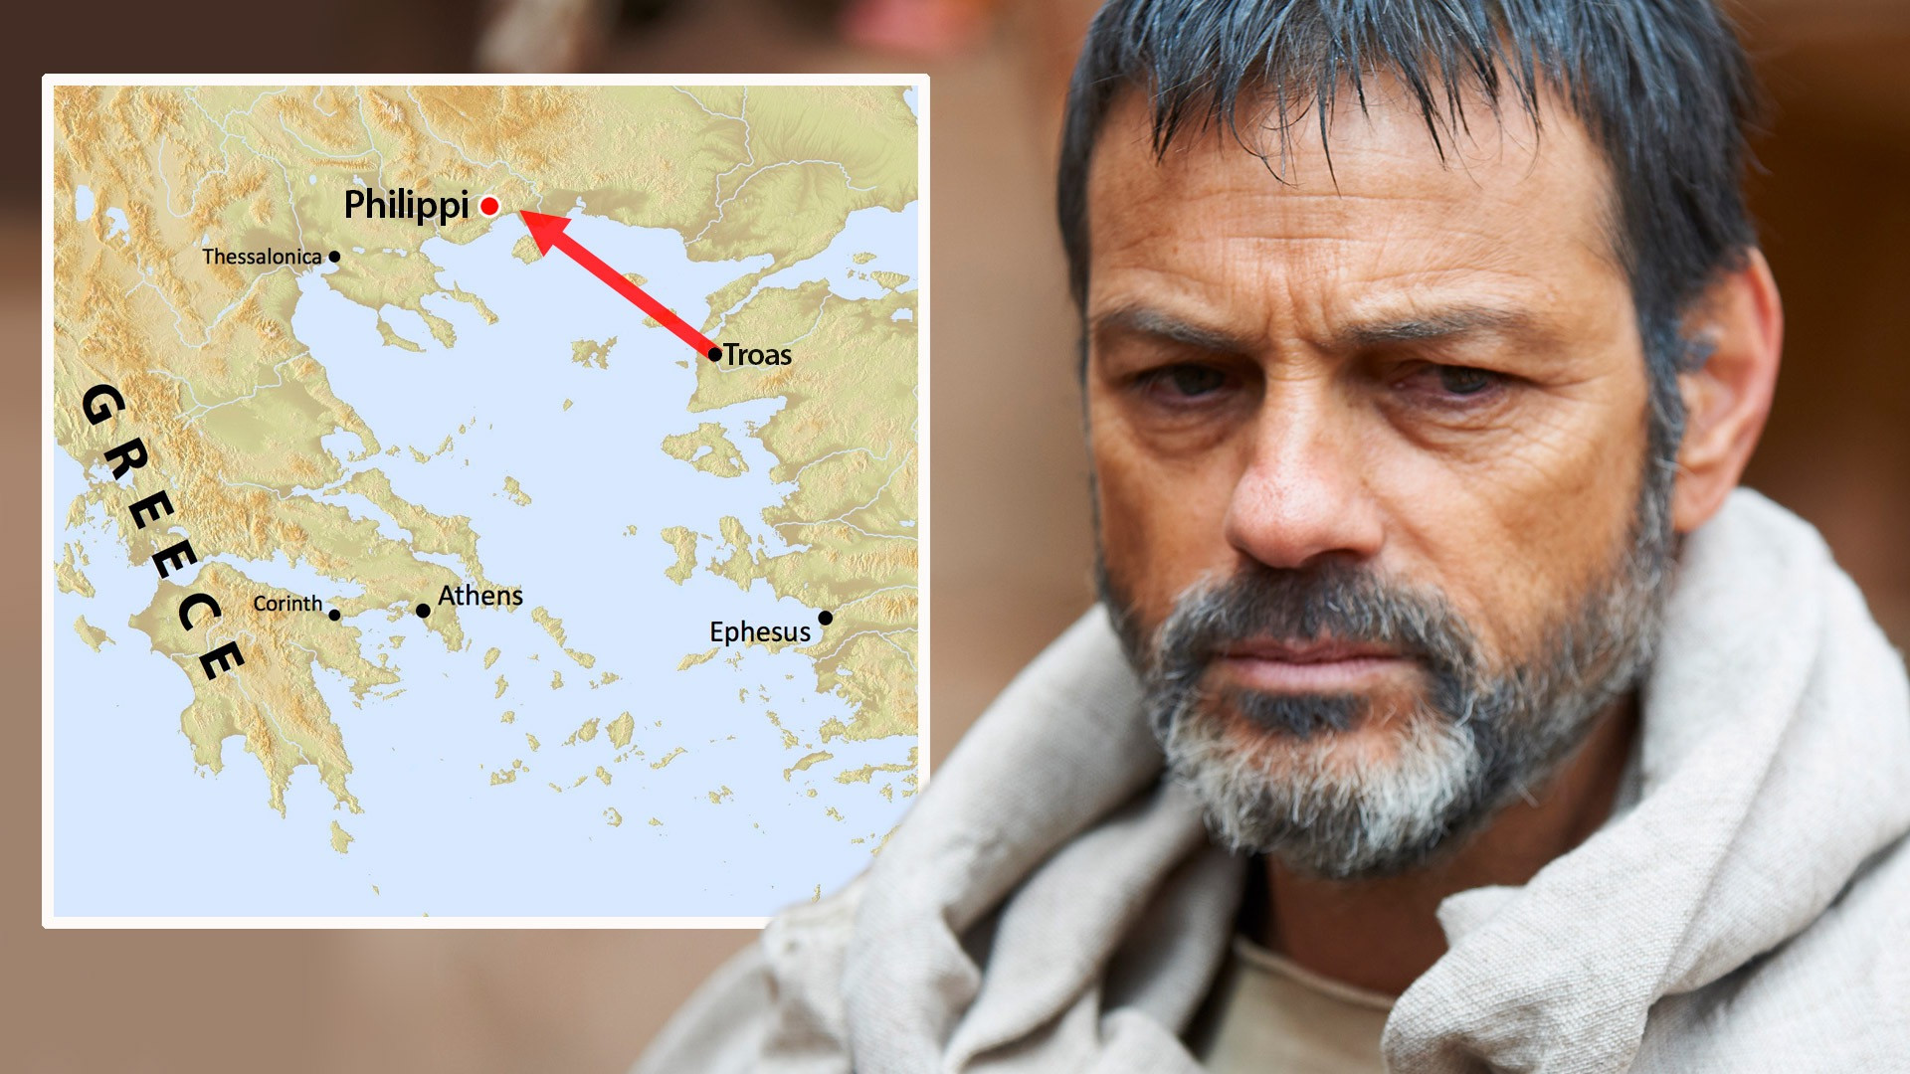
Acts 16:11-12
Travel from Troas to Philippi

Slide 6
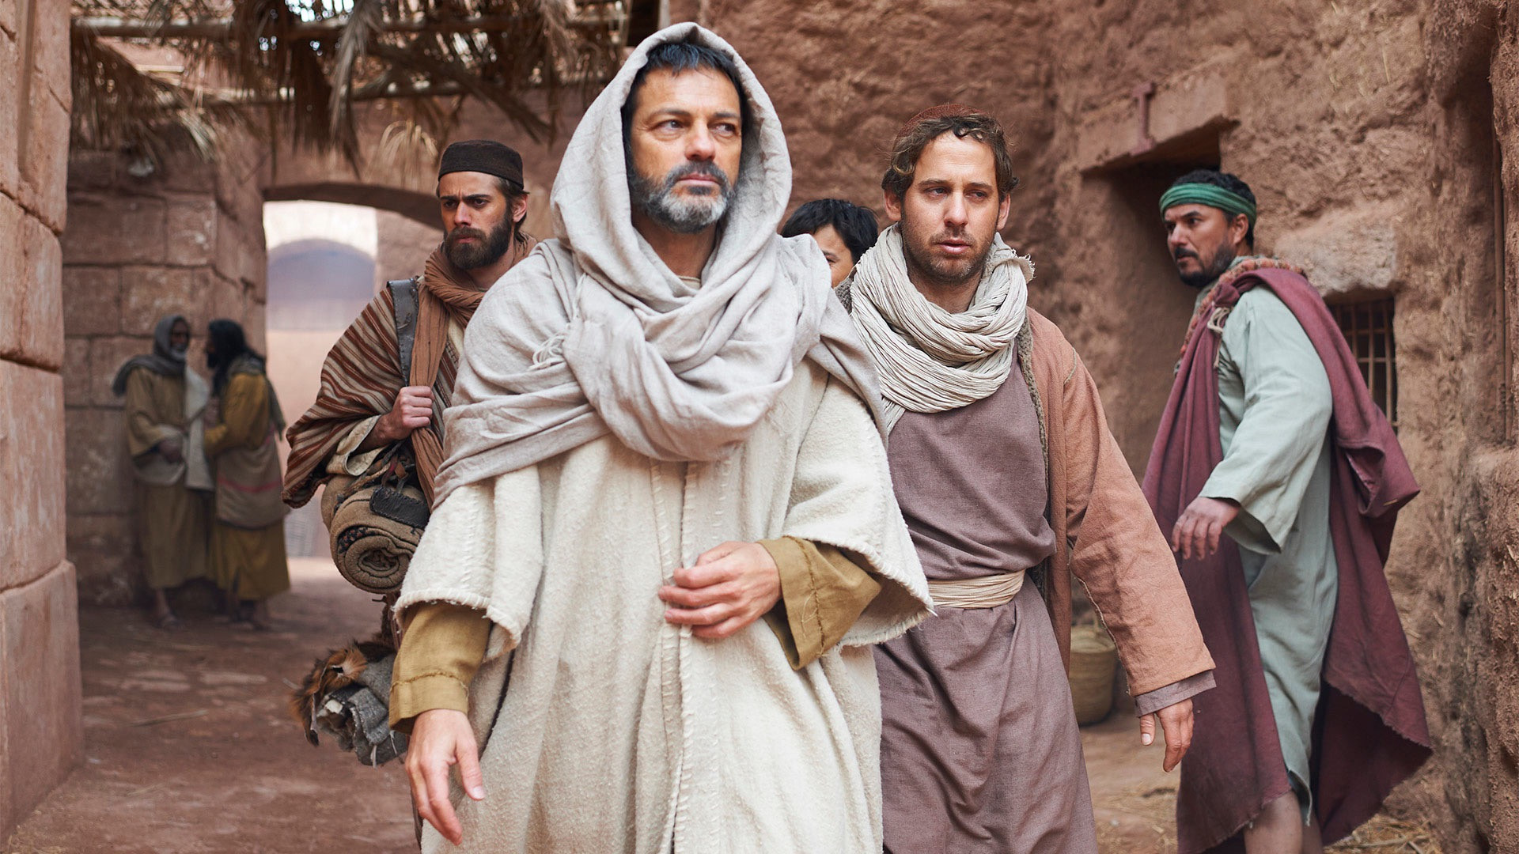
Taking the gospel to a new city…
Where would you start?

Slide 7
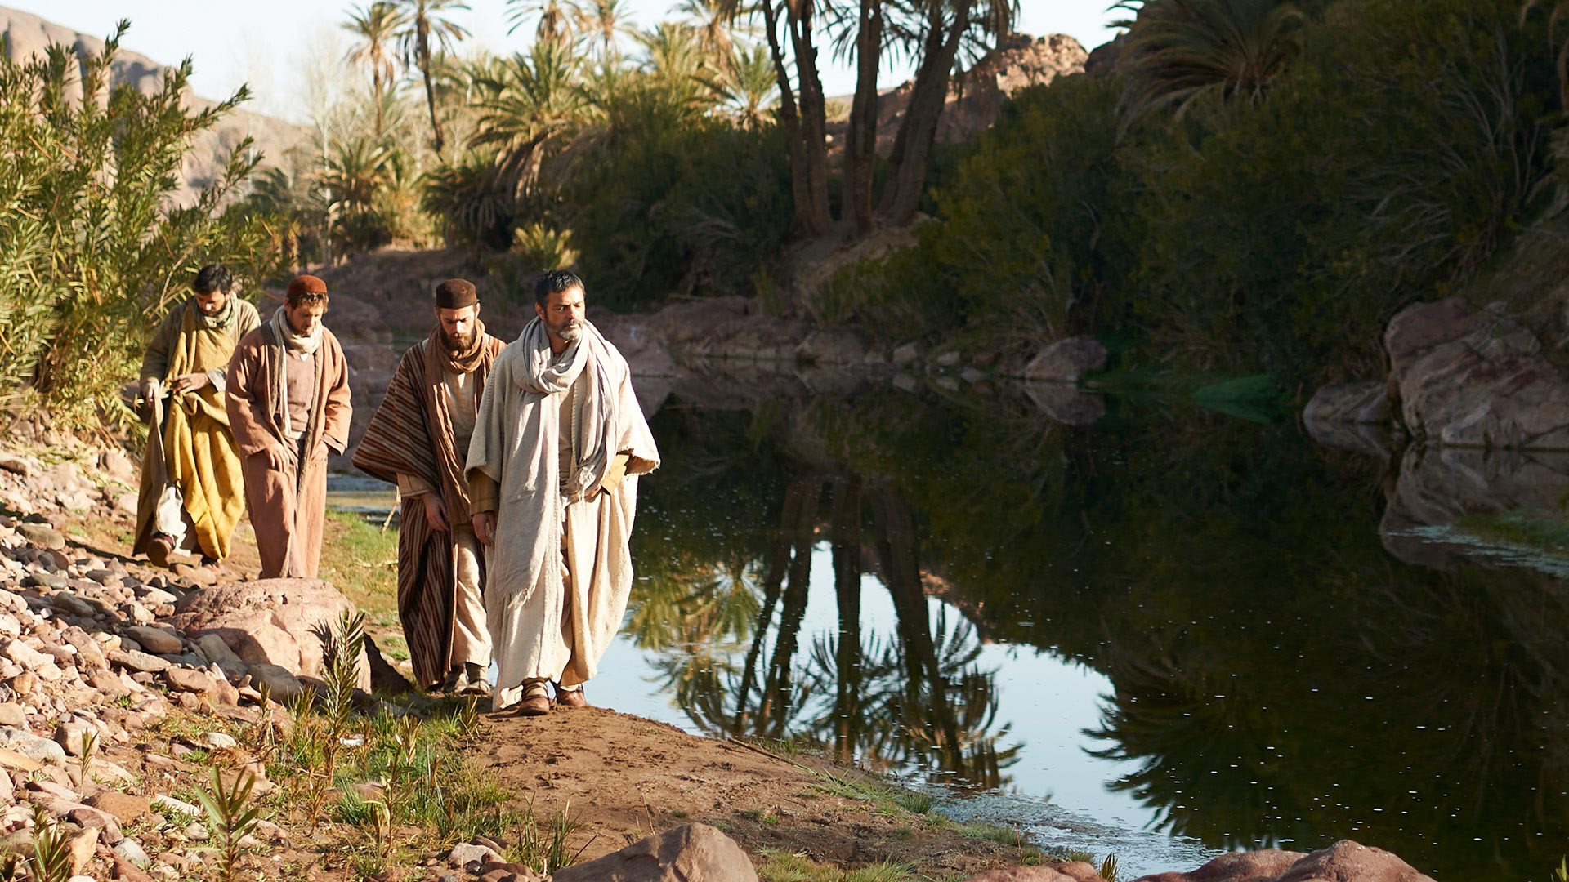
Acts 16:13 NLT
“On the Sabbath we went a little way outside the city to a riverbank, where we thought people would be meeting for prayer, and we sat down to speak with some women who had gathered there.”

Slide 8
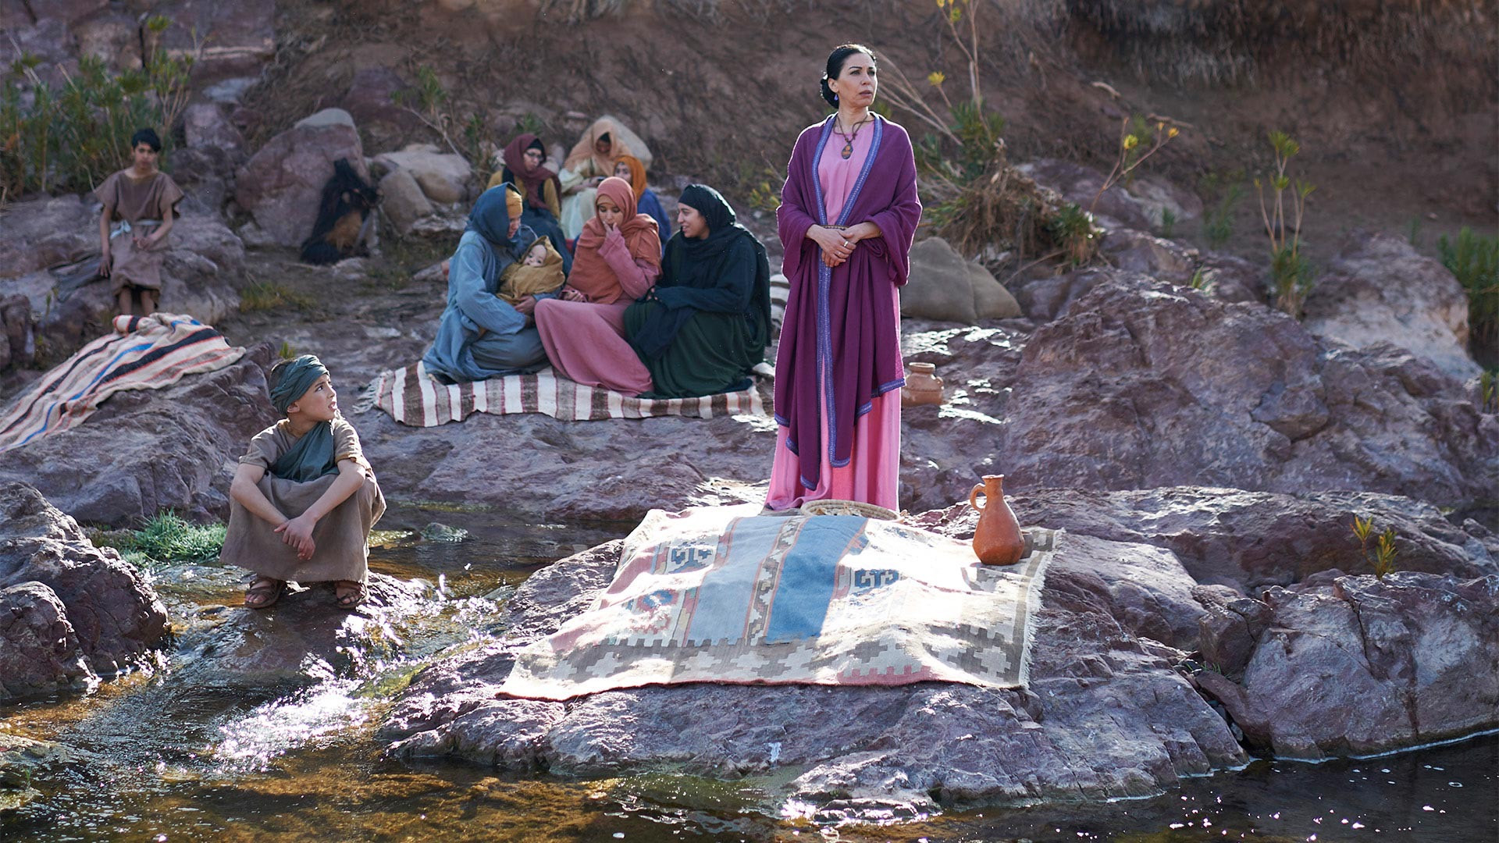
Acts 16:14a NLT
“One of them was Lydia from Thyatira, a merchant of expensive purple cloth, who worshiped God.”

Slide 9
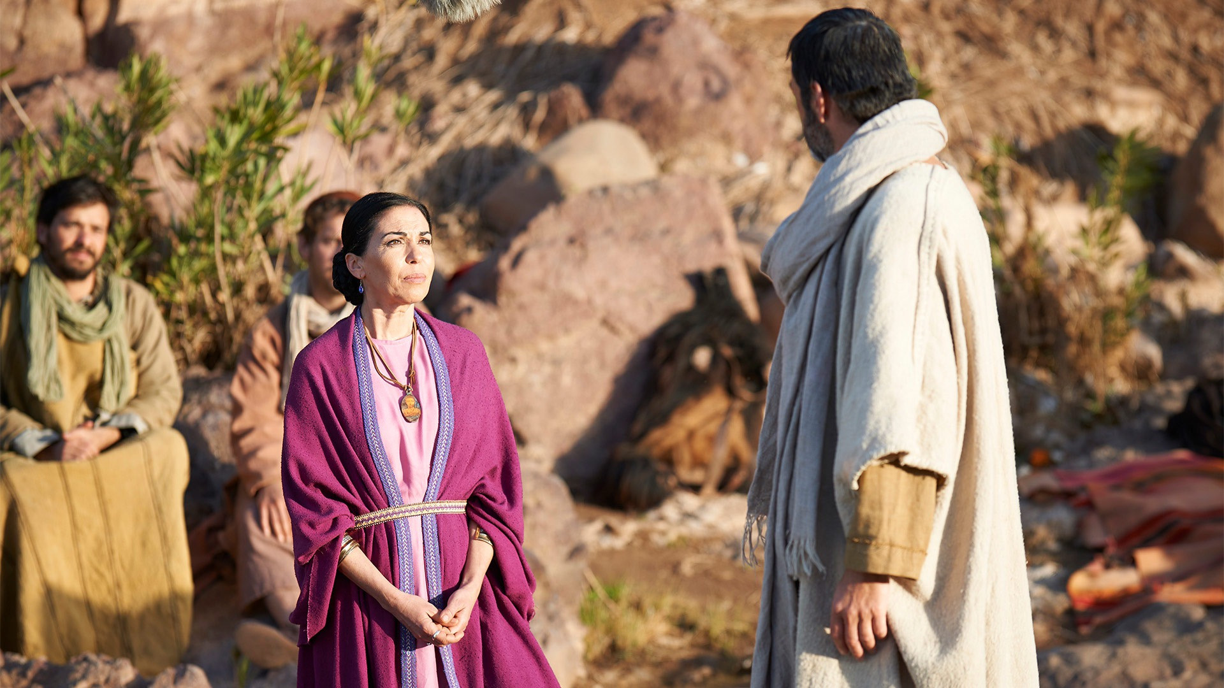
Acts 16:14b NLT
“As she listened to us, the Lord opened her heart, and she accepted what Paul was saying.”

Slide 10
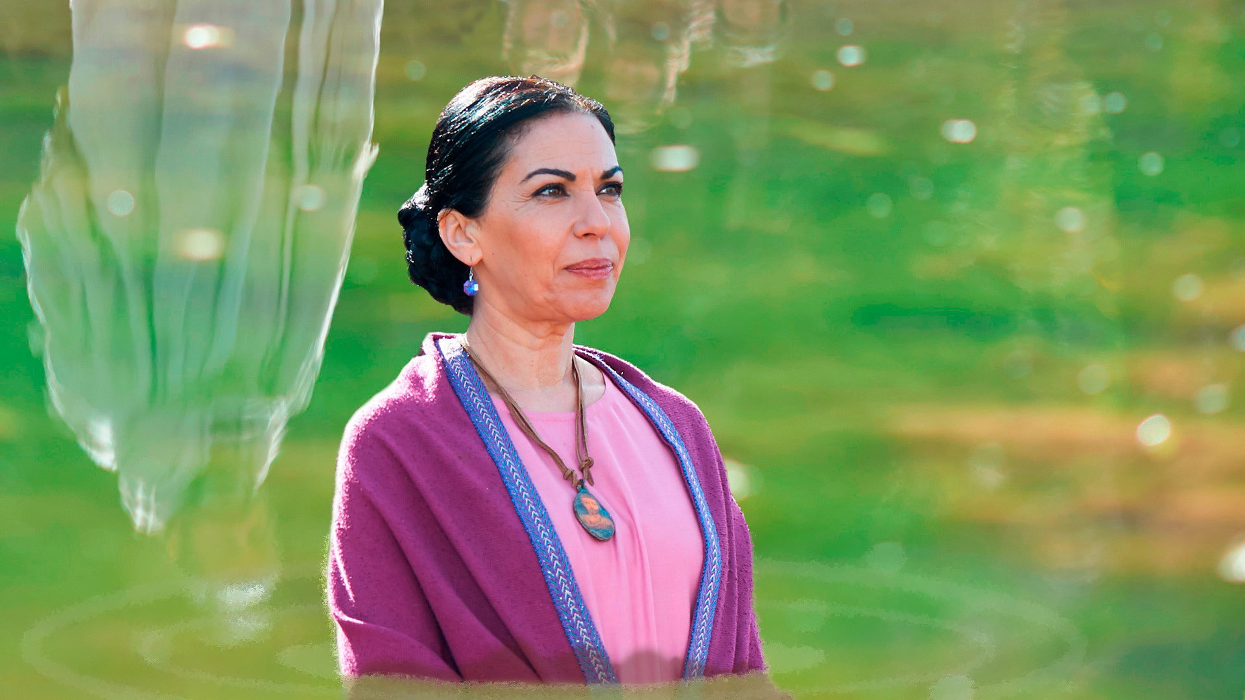
Acts 16:15a NLT
“She and her household were baptized...”
Household – Greek oikos
Why do you think her oikos was baptized?
Notes:
We’ll get to household baptism with the Philippian jailer story…

Slide 11
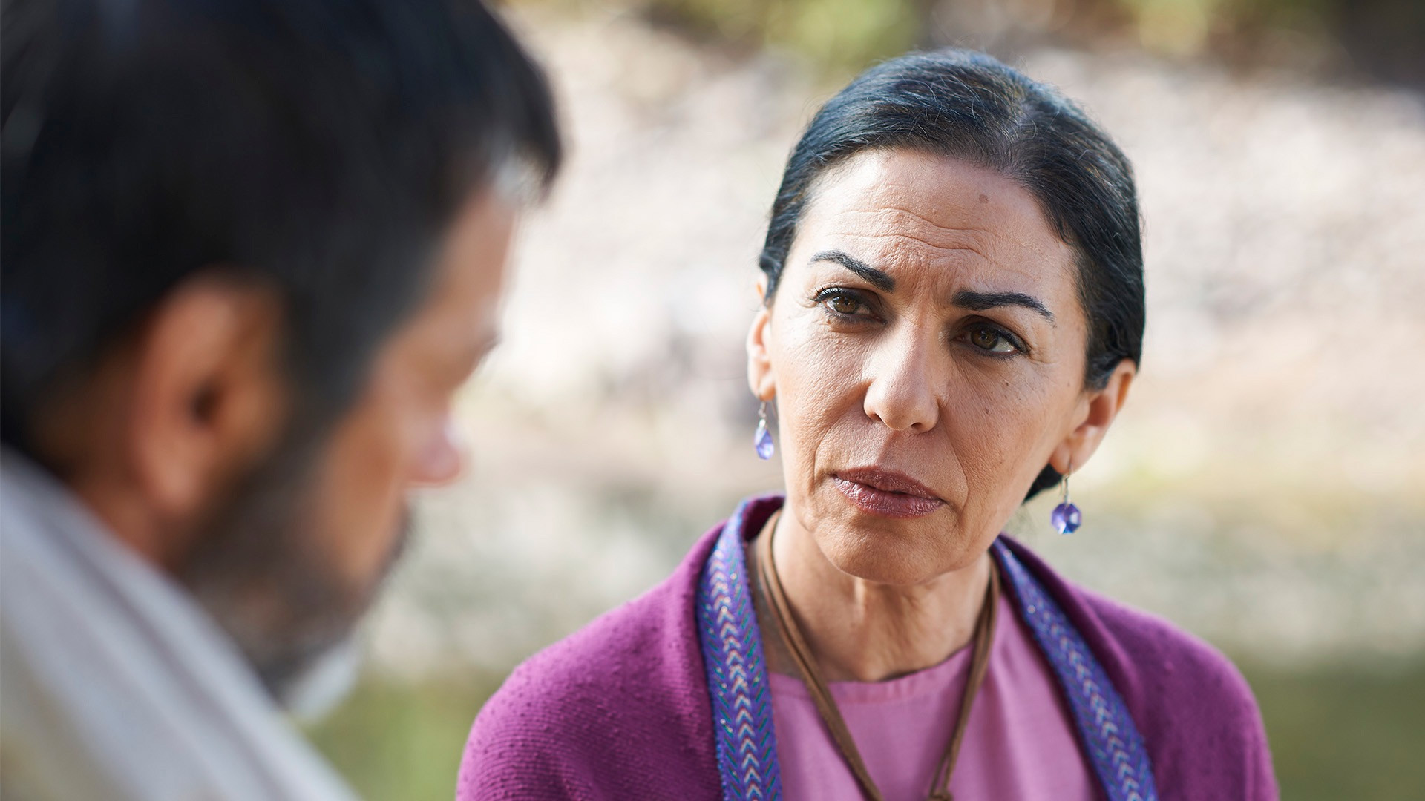
Acts 16:15b NLT
“ ‘If you agree that I am a true believer in the Lord,’ she said, ‘come and stay at my home.’ And she urged us until we agreed.”

Slide 12
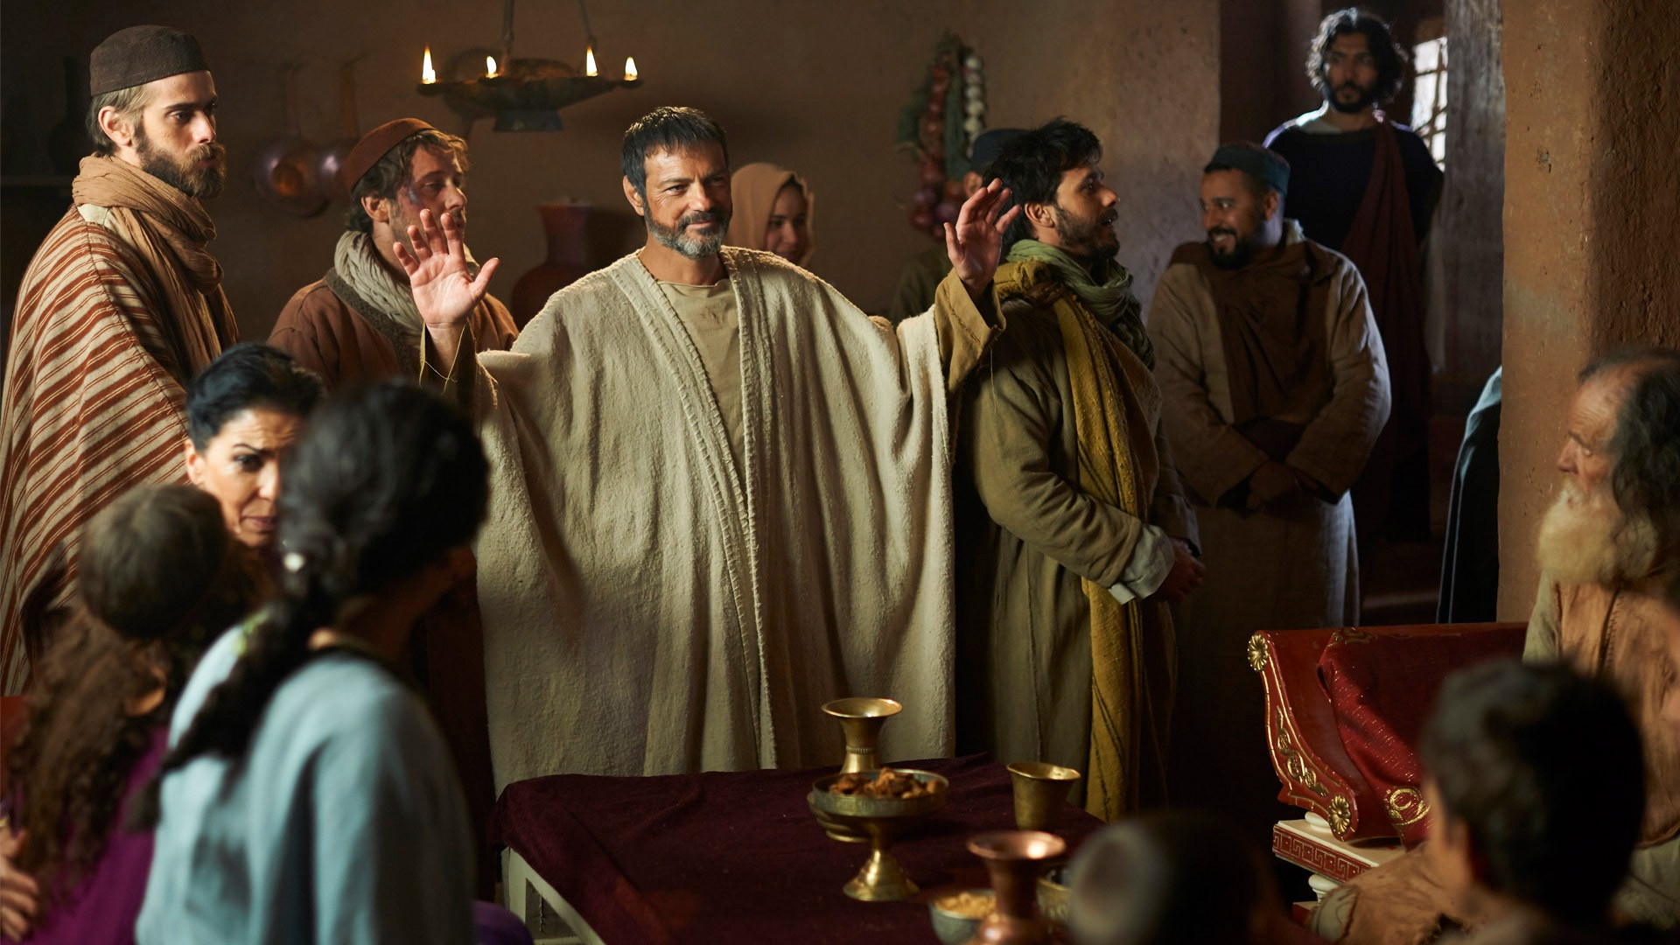
How would you describe Lydia’s role in the early Philippian church – did she “attend” or did she “participate”?

Slide 13
How would someone from Lydia’s oikos have described what church was for them?
A building to go to?
A meeting to attend?
A Holy Spirit filled network of relationships!

Slide 14
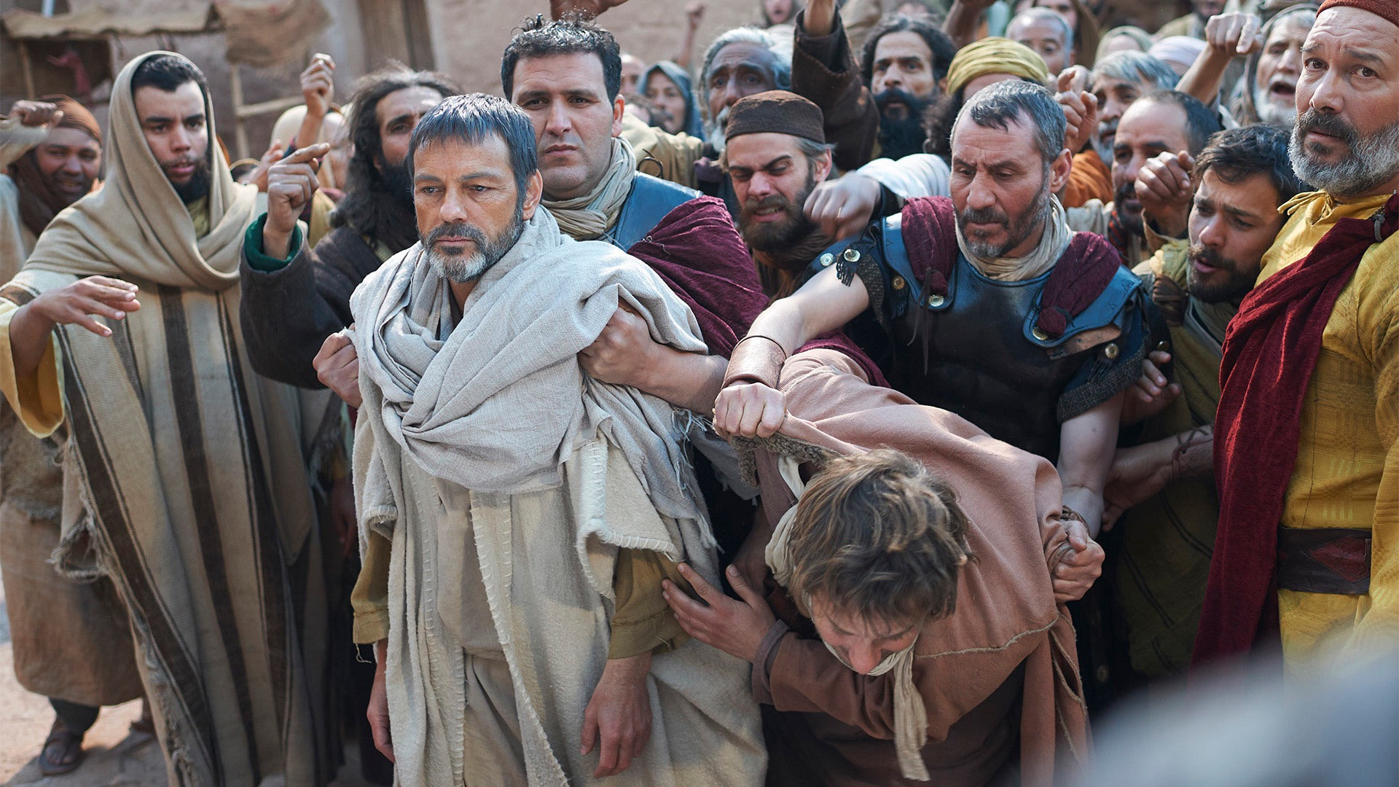
Acts 16:16-22 NLT
Notes:
Acts 16:16 One day as we were going down to the place of prayer, we met a slave girl who had a spirit that enabled her to tell the future. She earned a lot of money for her masters by telling fortunes. ¹⁷ She followed Paul and the rest of us, shouting, “These men are servants of the Most High God, and they have come to tell you how to be saved.”
Acts 16:18 This went on day after day until Paul got so exasperated that he turned and said to the demon within her, “I command you in the name of Jesus Christ to come out of her.” And instantly it left her.
Acts 16:19 Her masters’ hopes of wealth were now shattered, so they grabbed Paul and Silas and dragged them before the authorities at the marketplace. ²⁰ “The whole city is in an uproar because of these Jews!” they shouted to the city officials. ²¹ “They are teaching customs that are illegal for us Romans to practice.” ²² A mob quickly formed against Paul and Silas, and the city officials ordered them stripped and beaten with wooden rods.
NLT

Slide 15
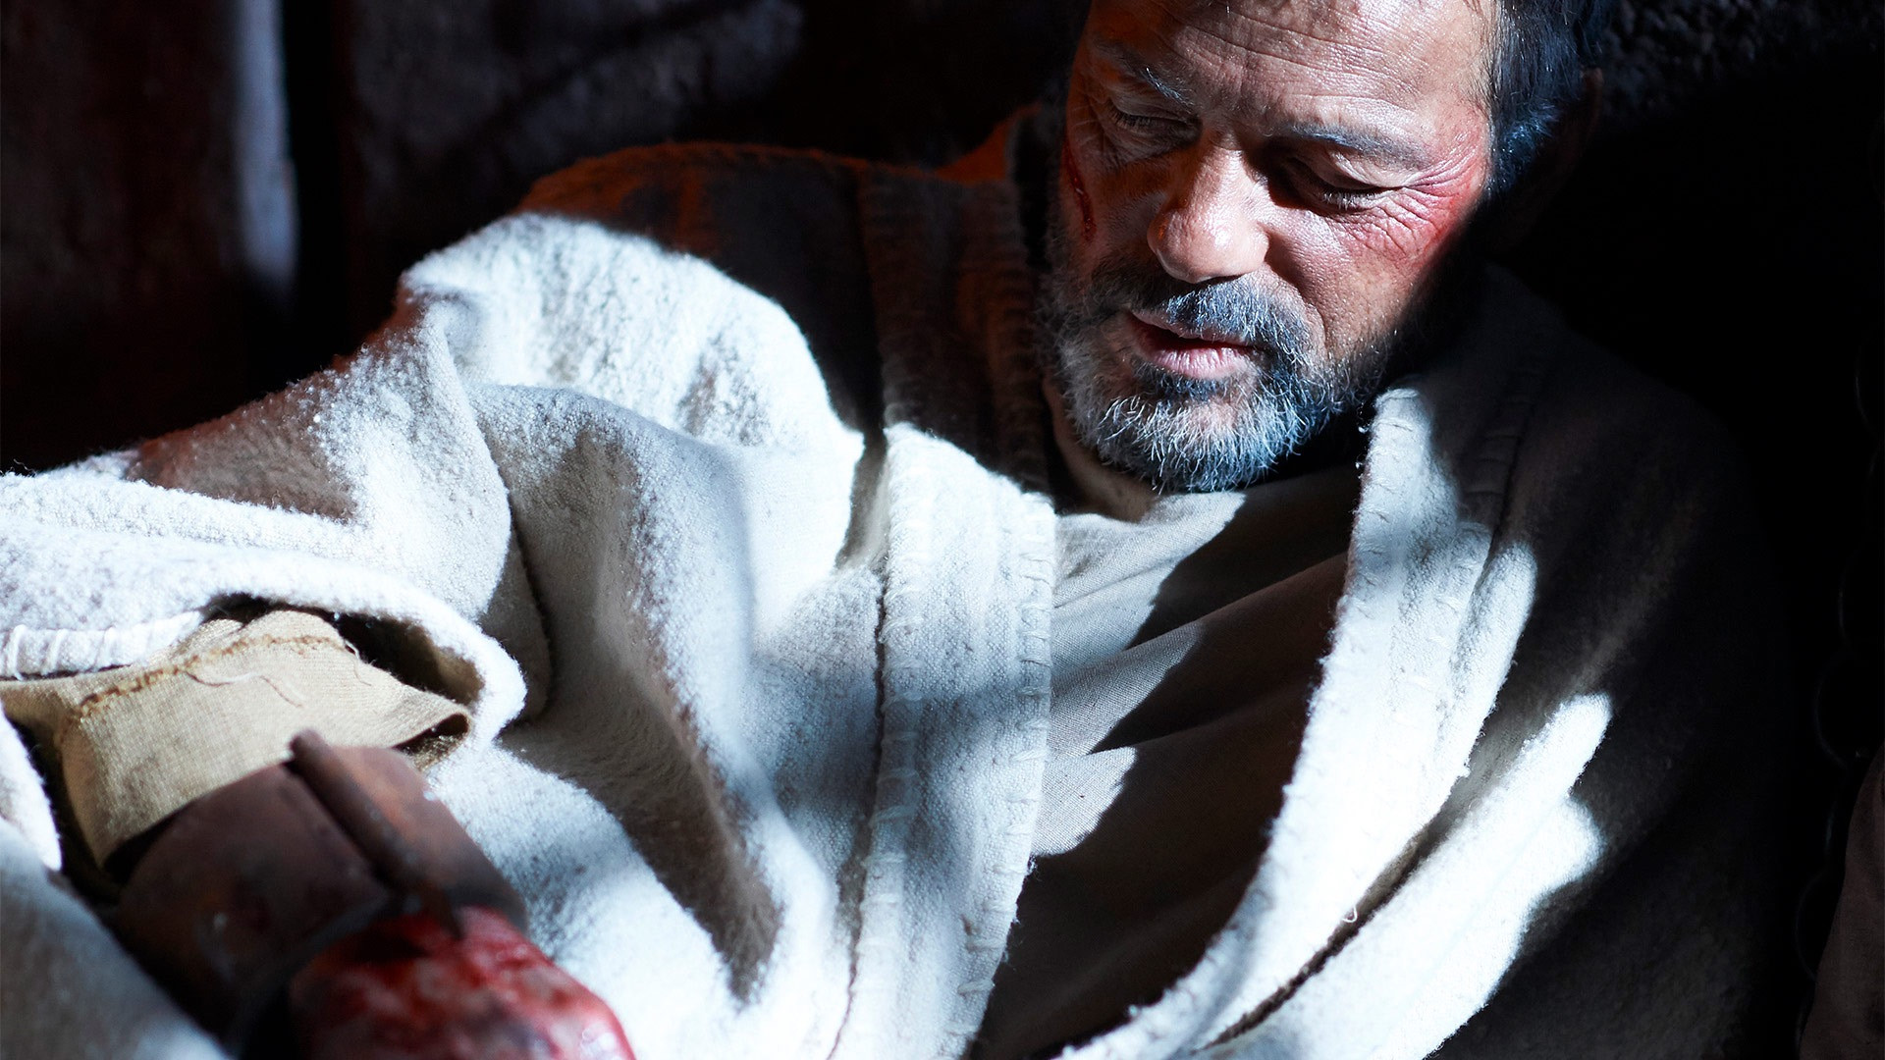
Acts 16:23-25 NLT
Notes:
²³ They were severely beaten, and then they were thrown into prison. The jailer was ordered to make sure they didn’t escape. ²⁴ So the jailer put them into the inner dungeon and clamped their feet in the stocks.
Acts 16:25 Around midnight Paul and Silas were praying and singing hymns to God, and the other prisoners were listening.

Slide 16
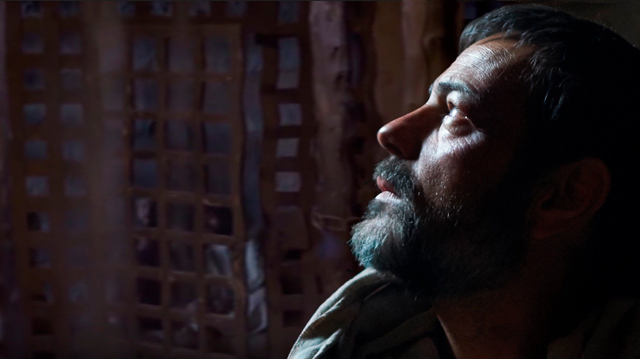
Acts 16:26 NLT
Notes:
“Suddenly, there was a massive earthquake, and the prison was shaken to its foundations. All the doors immediately flew open, and the chains of every prisoner fell off!”

Slide 17
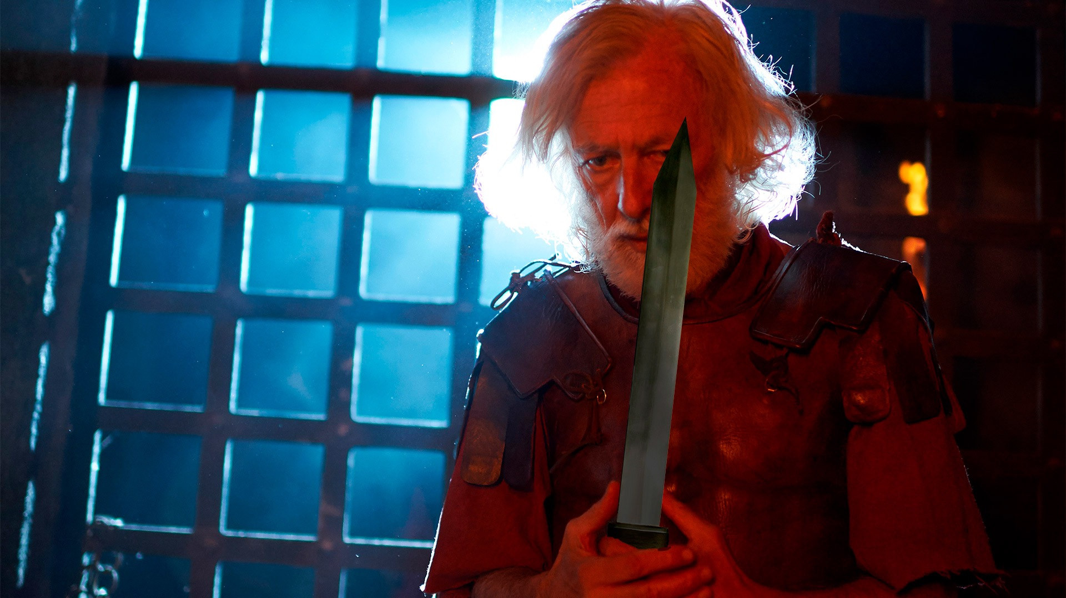
Acts 16:27 NLT
Notes:
“The jailer woke up to see the prison doors wide open. He assumed the prisoners had escaped, so he drew his sword to kill himself.”

Slide 18
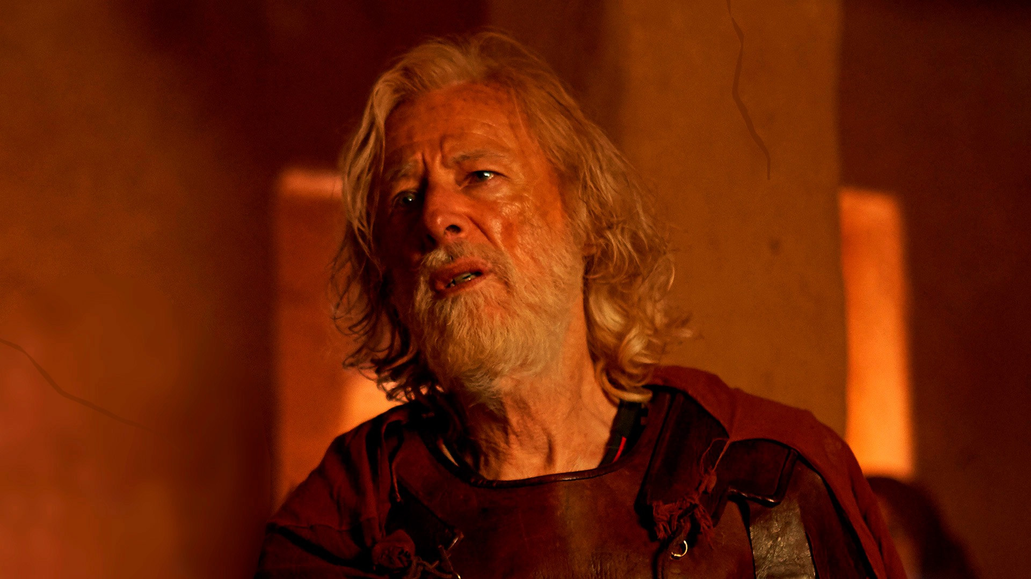
Acts 16:28-30 NLT
“But Paul shouted to him, ‘Stop! Don’t kill yourself! We are all here!’ The jailer called for lights and ran to the dungeon and fell down trembling before Paul and Silas. Then he brought them out and asked, ‘Sirs, what must I do to be saved?’”

Slide 19
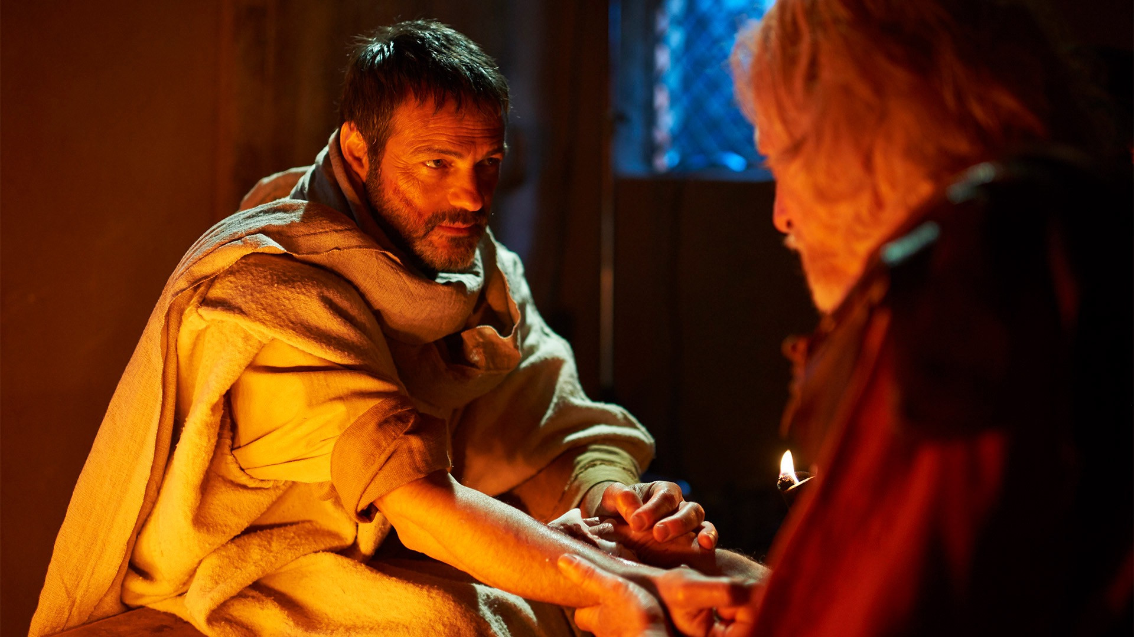
Acts 16:31-32 NLT
“They replied, ‘Believe in the Lord Jesus and you will be saved, along with everyone in your household.’ And they shared the word of the Lord with him and with all who lived in his household.”

Slide 20
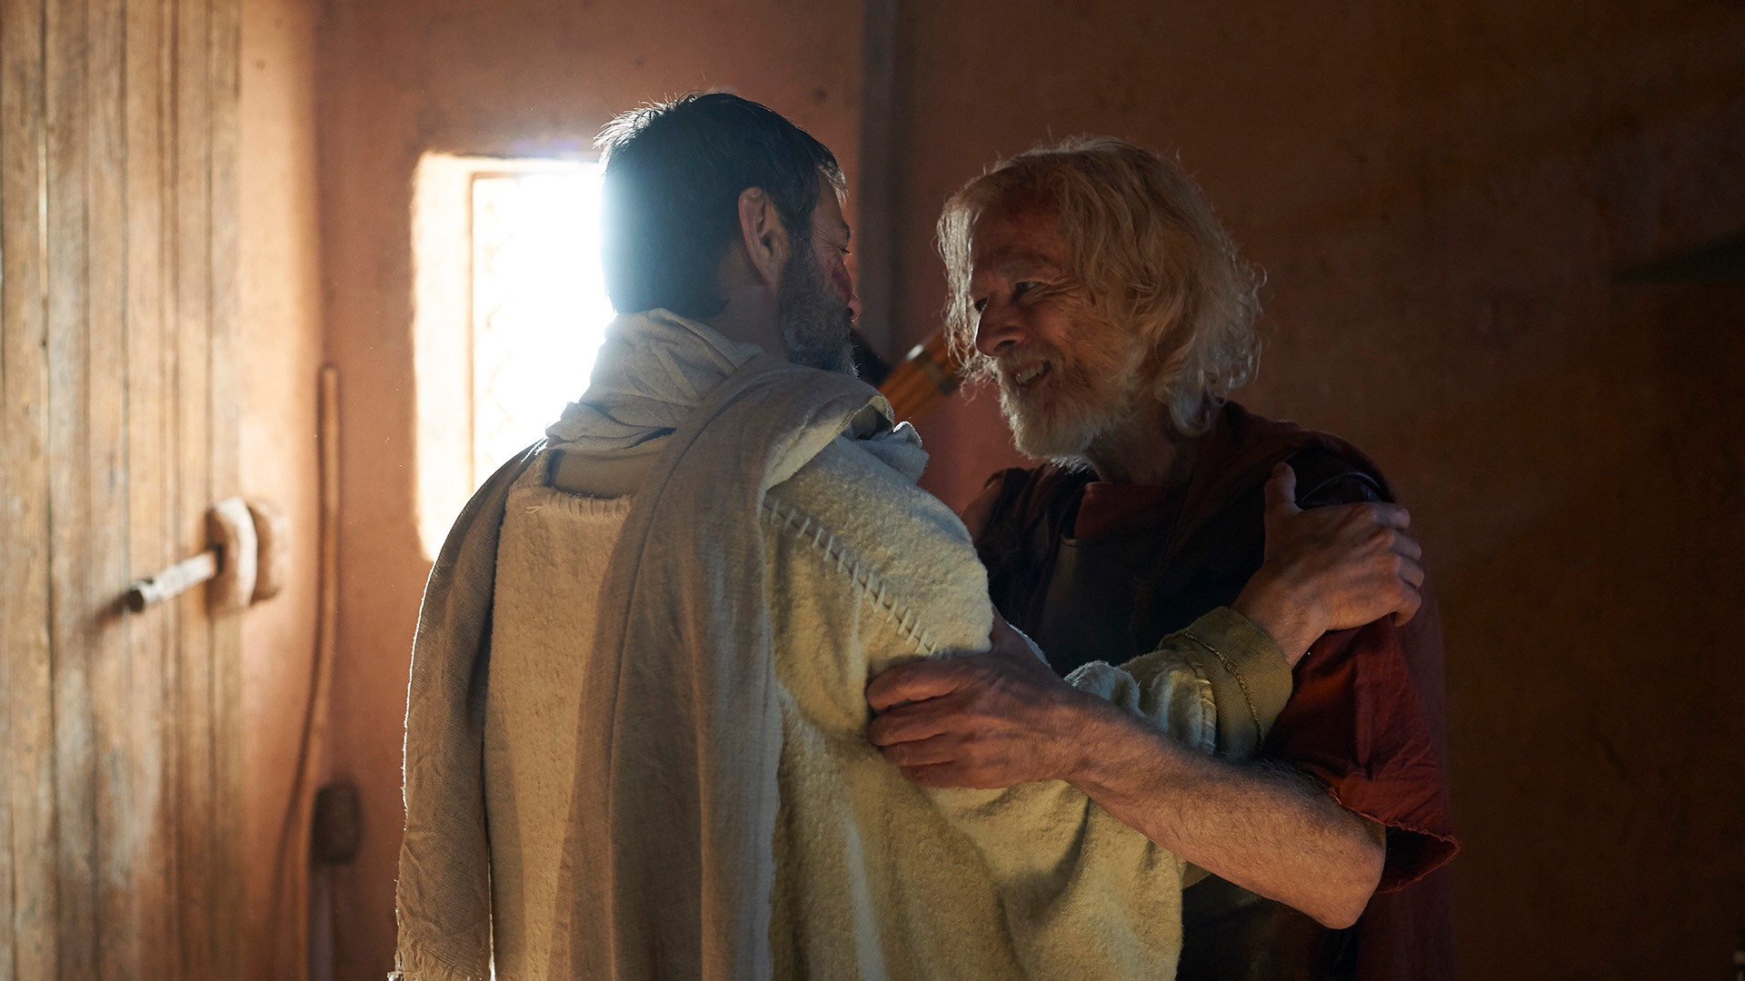
Acts 16:33 NLT
“Even at that hour of the night, the jailer cared for them and washed their wounds. Then he and everyone in his household were immediately baptized.”

Slide 21
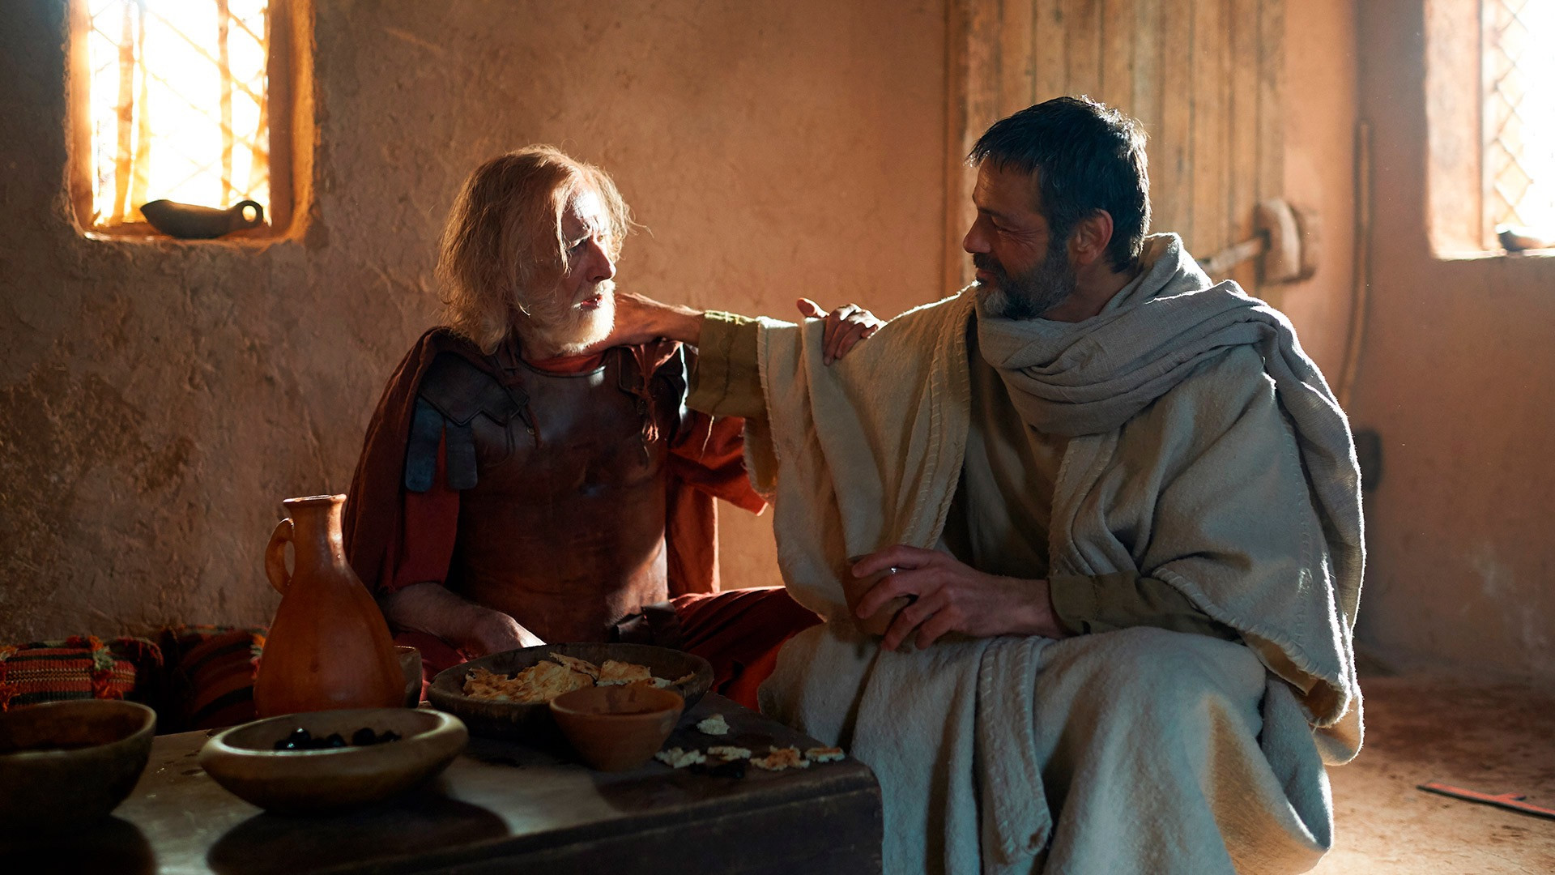
Acts 16:34 NLT
“He brought them into his house and set a meal before them, and he and his entire household rejoiced because they all believed in God.”
Notes:
Acts 16:35 The next morning the city officials sent the police to tell the jailer, “Let those men go!” ³⁶ So the jailer told Paul, “The city officials have said you and Silas are free to leave. Go in peace.”
Acts 16:37 But Paul replied, “They have publicly beaten us without a trial and put us in prison—and we are Roman citizens. So now they want us to leave secretly? Certainly not! Let them come themselves to release us!”
Acts 16:38 When the police reported this, the city officials were alarmed to learn that Paul and Silas were Roman citizens. ³⁹ So they came to the jail and apologized to them. Then they brought them out and begged them to leave the city.

Slide 22
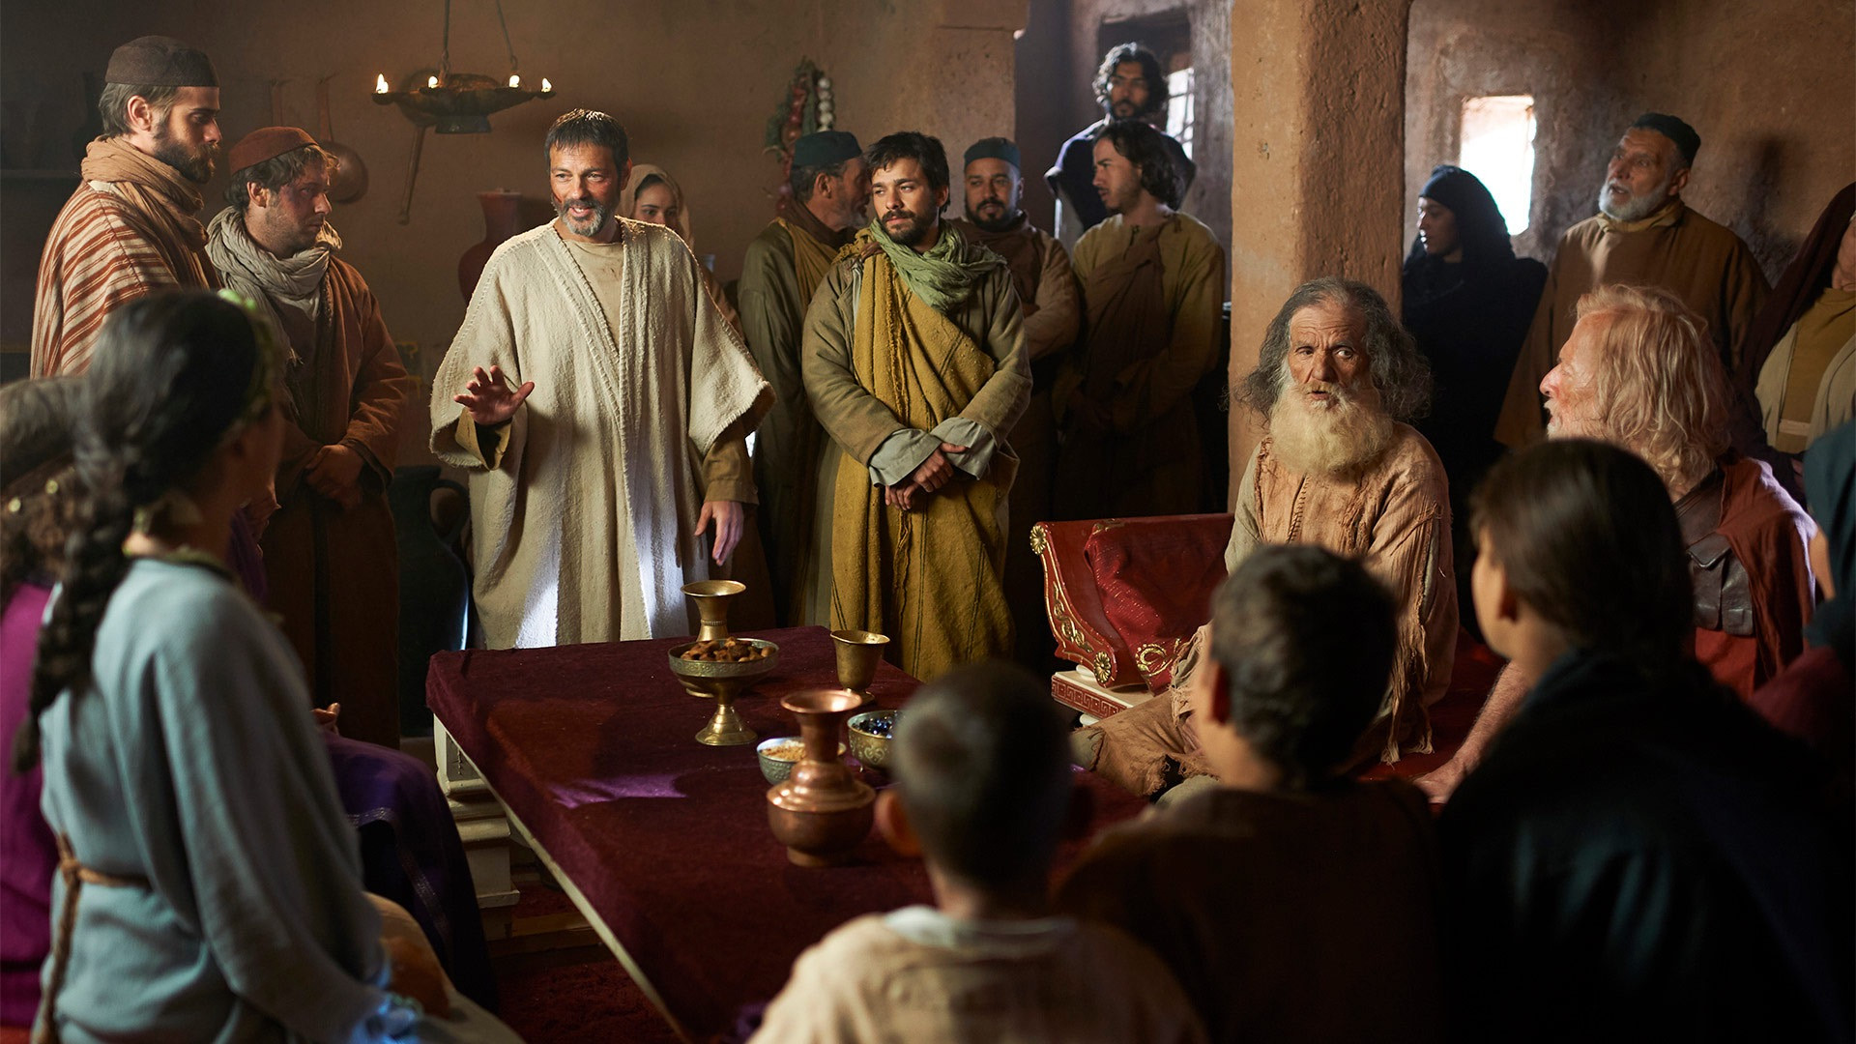
Acts 16:40 NLT
“When Paul and Silas left the prison, they returned to the home of Lydia. There they met with the believers and encouraged them once more. Then they left town.”

Slide 23
At this point, who was part of the church in Philippi?

Slide 24
And then what happened?
Acts 17:1
Travel from Philippi to Thessalonica

Slide 25
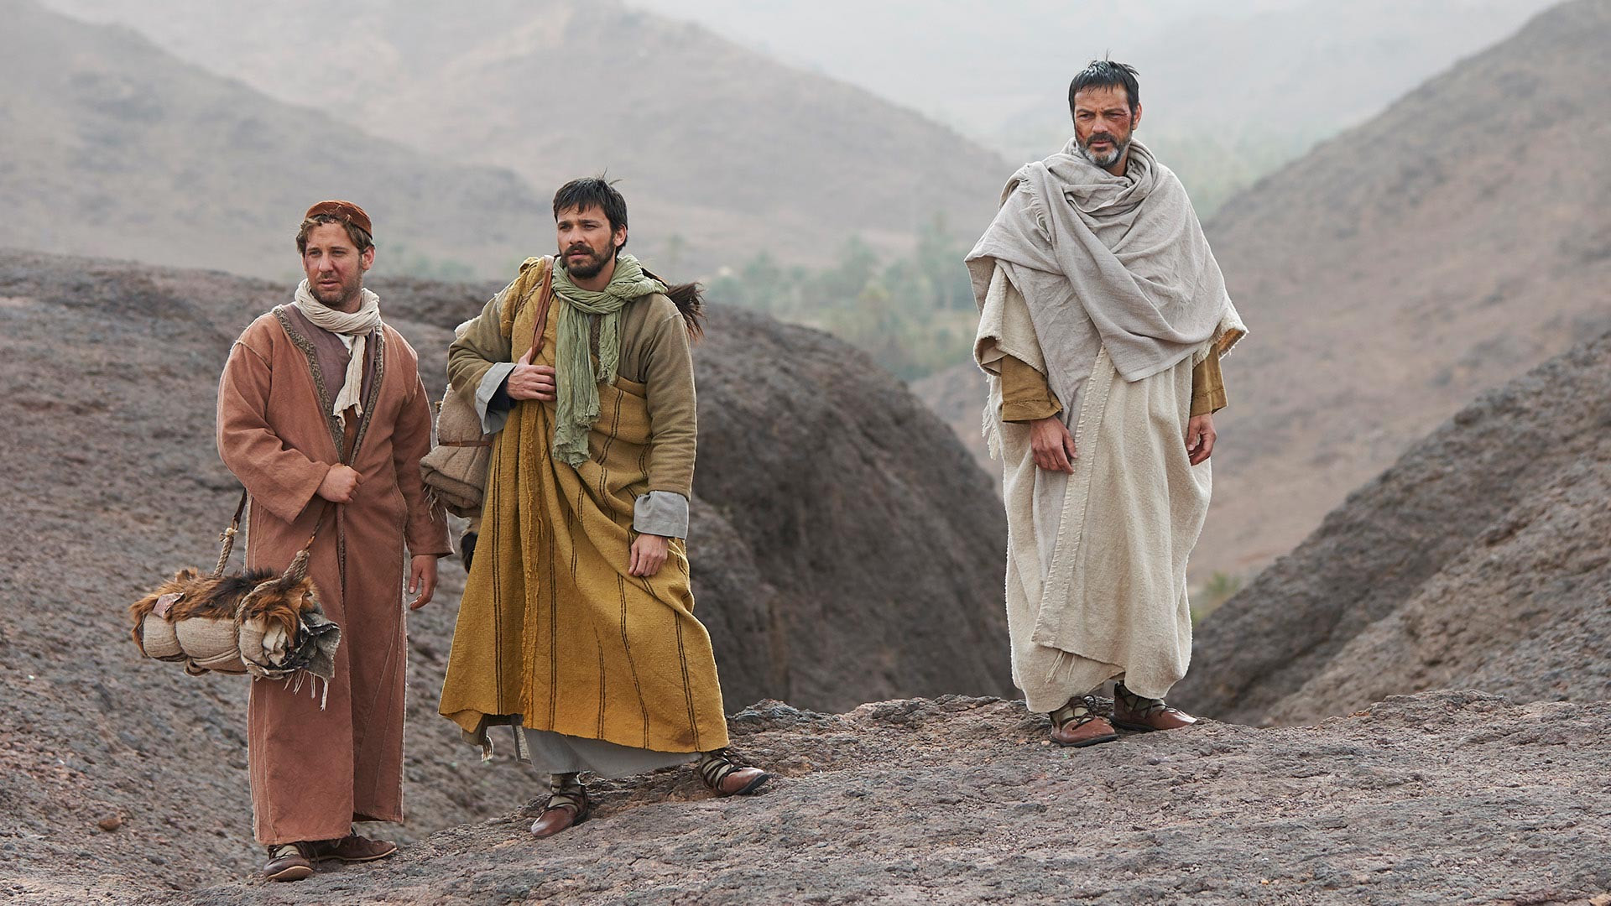
“As you know, you Philippians were the only ones who gave me financial help when I first brought you the Good News and then traveled on from Macedonia. No other church did this. Even when I was in Thessalonica you sent help more than once.” Philippians 4:15-16

Slide 26
“For I can testify that [the churches of Macedonia] gave not only what they could afford, but far more. And they did it of their own free will. They begged us again and again for the privilege of sharing in the gift for the believers in Jerusalem.”
2 Corinthians 8:1-4

Slide 27
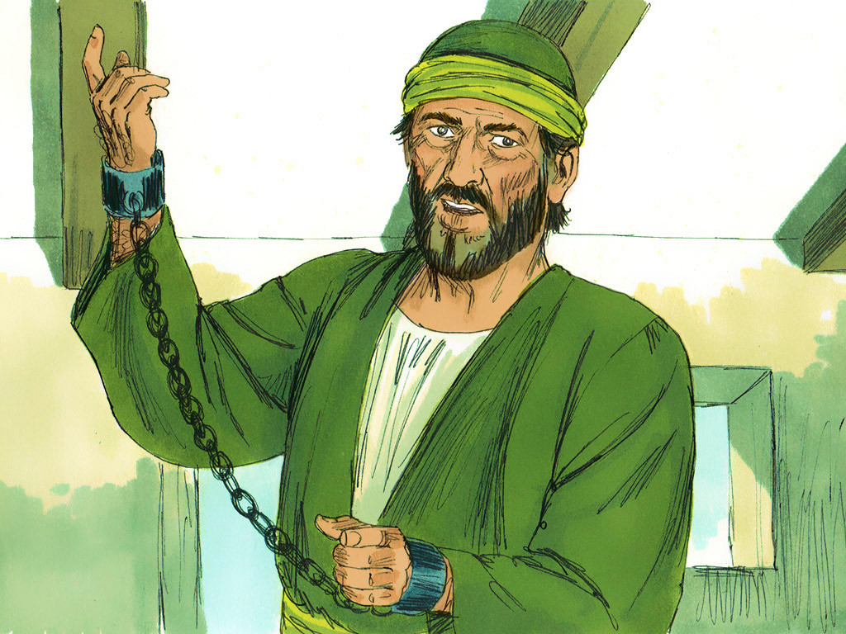
About 12 years later…
Paul was in prison in Rome.
Philippian church was still growing and thriving!
  How was this happening without “full-time” workers?
They heard Paul was in prison and sent Epaphroditus to care for his needs.

Slide 28
Paul’s Response…
The letter to the Philippians!
“I thank my God in all my remembrance of you, always in every prayer of mine for you all making my prayer with joy, because of your partnership in the gospel from the first day until now.” Philippians 1:3-5

Slide 29
Paul’s Response…
The book of Philippians is, in part, a thank you from Paul for the gift sent with Epaphroditus!
“At the moment I have all I need—and more! I am generously supplied with the gifts you sent me with Epaphroditus. They are a sweet-smelling sacrifice that is acceptable and pleasing to God.” Philippians 4:18

Slide 30
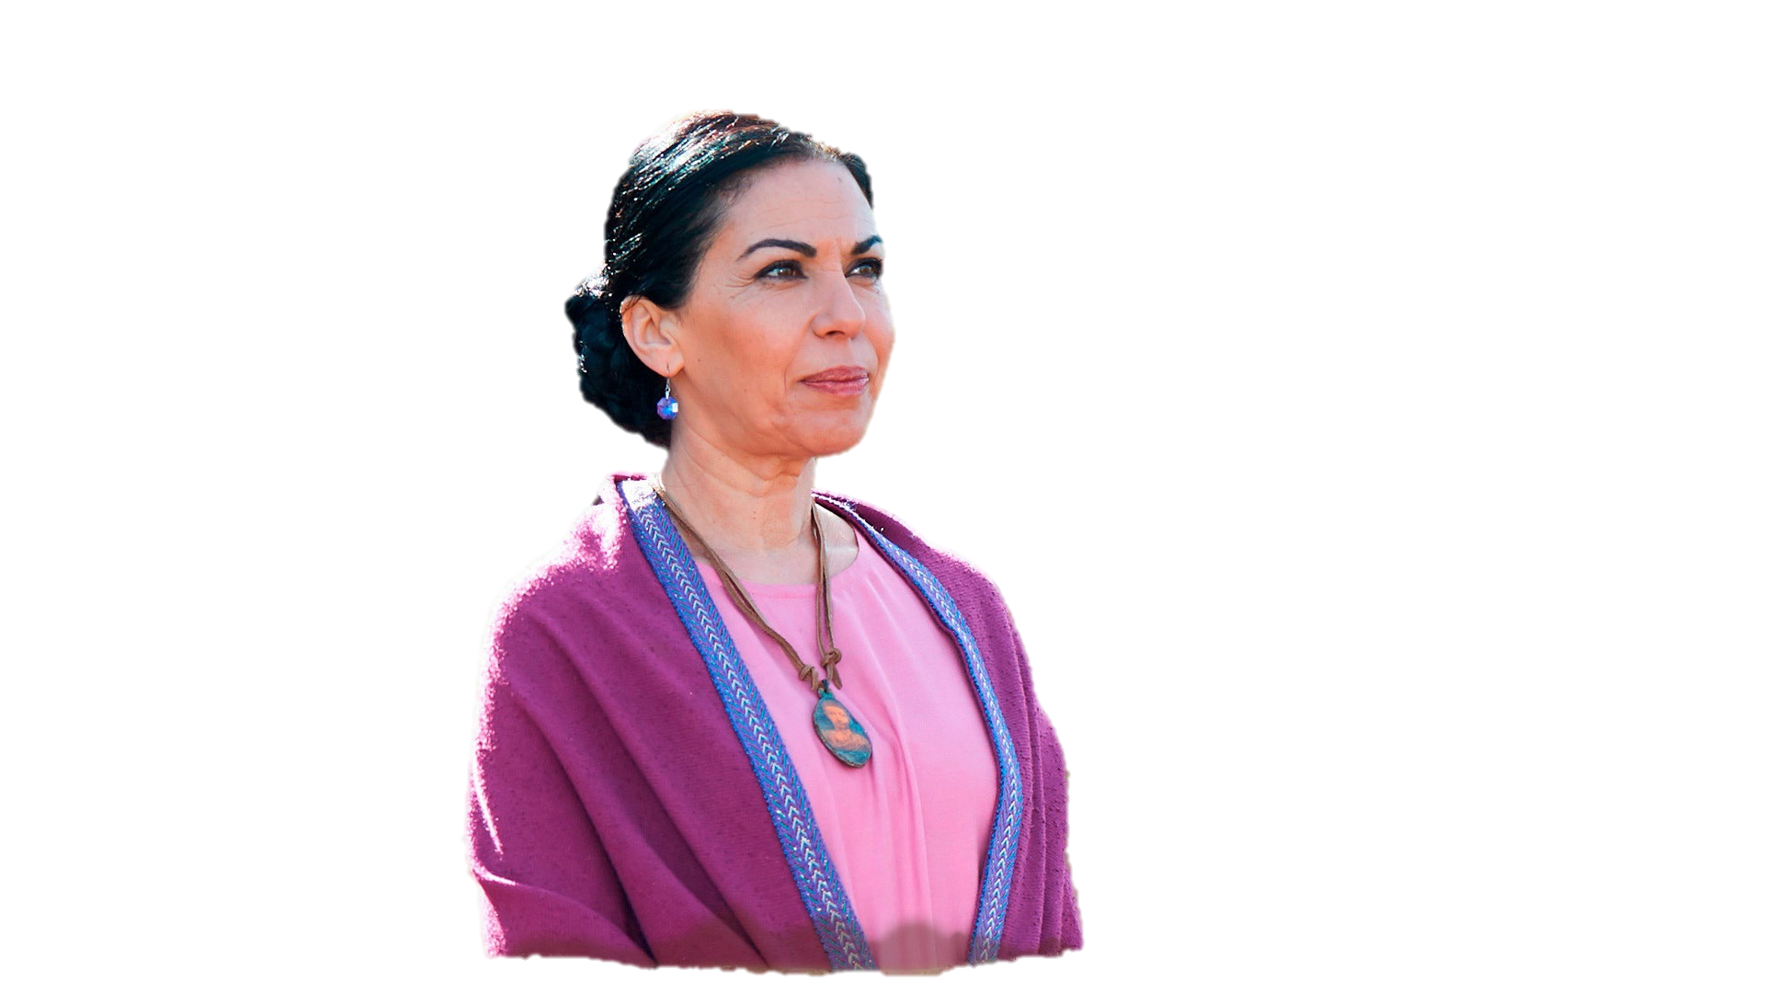
Some roles in the early church…
Paul and his team – traveling apostles and evangelists
Timothy – Started with Paul, but then took on the role of a more stationary pastor
Lydia (and many others!) – Lay people who were key participants in the early church

Slide 31
Together, they were all “partners in the gospel”!
Would Paul consider you a “partner in the gospel”?
Paul and his team – traveling apostles and evangelists
Timothy – Started with Paul, but then took on the role of a more stationary pastor
Lydia (and many others!) – Lay people who were key participants in the early church

Slide 32
How can we become “partners in the gospel”?
Do you financially support the work of the gospel – either inside or outside of AIC?
Do you pray for the spread of the gospel?
Have you identified you role in personally contributing to the growth of the gospel?

Slide 33
How can we become “partners in the gospel”?
What is your primary contribution to the body of Christ here in Jordan – Inside or outside of this church?
  Starts with our own families!
  Relationships with unbelievers
  Hosting people in your home
  Leading small groups / Bible studies
  Discipling younger believers
  Teaching children or youth
  Serving as an elder / deacon

Slide 34
How can we become “partners in the gospel”?
What are your plans for the next 30-45 minutes?

Slide 36


NT Preaching link at BibleStudyDownloads.org
Get this presentation and script for free!
Notes:
NT Preaching (np)

